Slide 1
Nuclear Fuel Performance
NE-533
Spring 2024

Slide 2
NUMERICAL THERMO-Mechanics

Slide 3
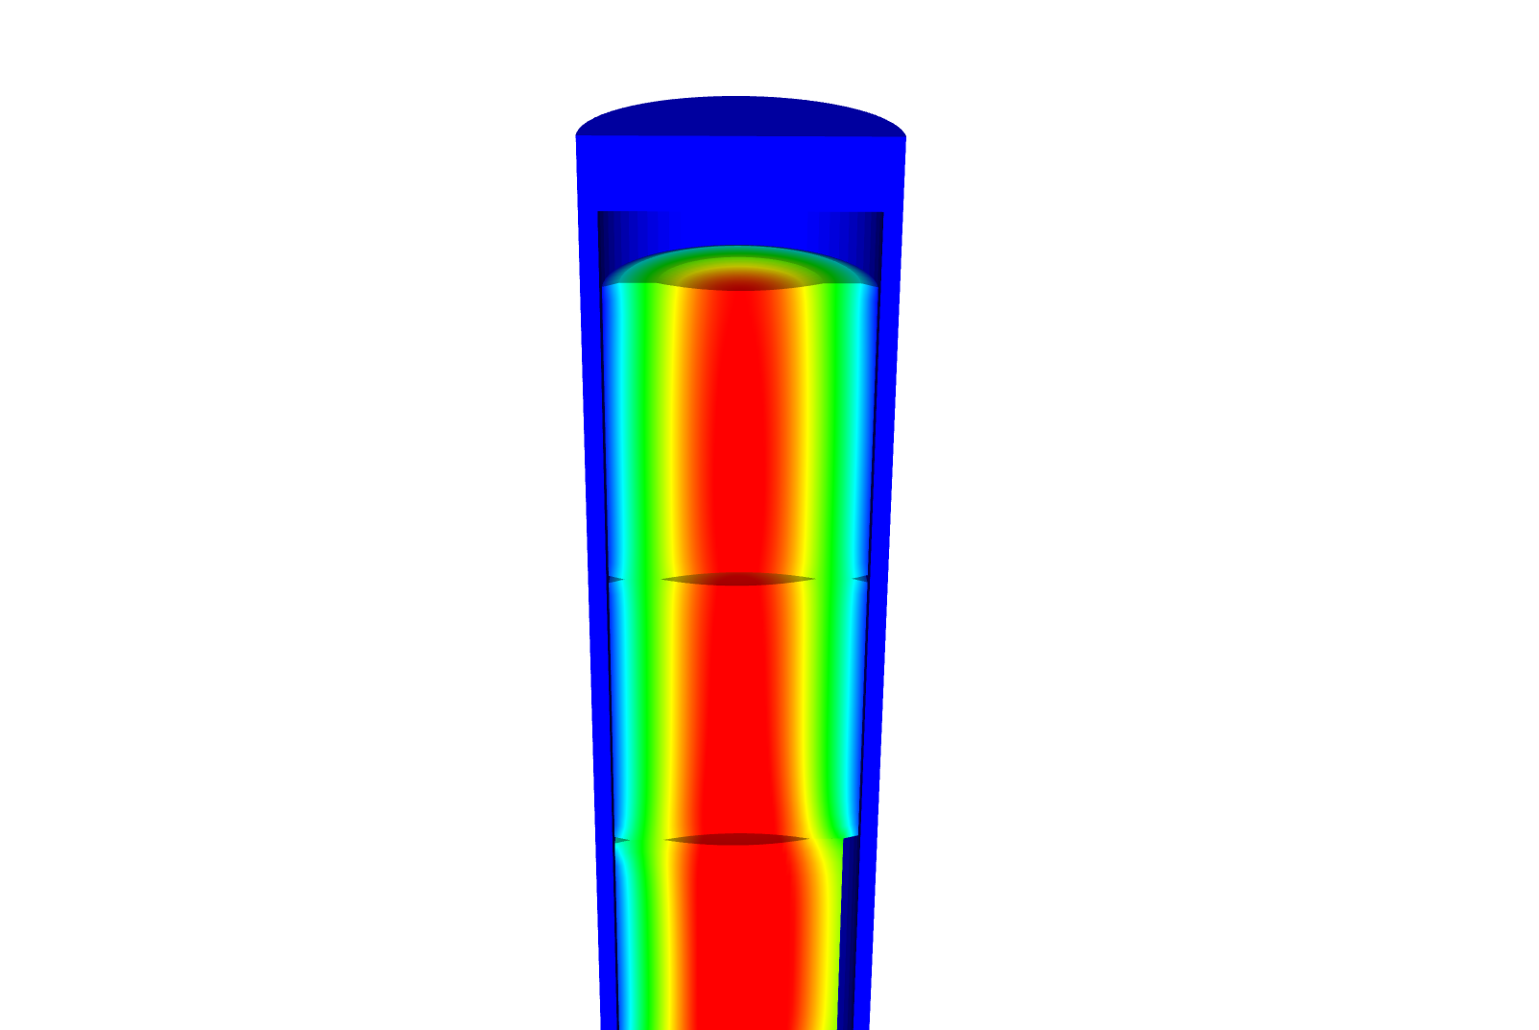
Now we can solve the temperature and the displacement vector for the full thermomechanical problem
T impacts the value of u through thermal expansion
u impacts the value of T through changes in the thickness of the gap
The value for T evolves with time
The value for u also evolves with time, even though there is not time in its PDE

Slide 4
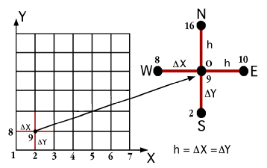
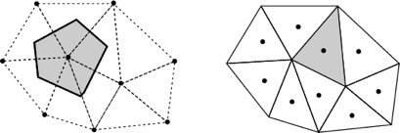
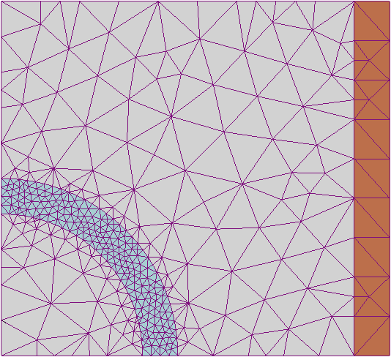
The primary tool for solving all thermomechanics problems is the finite element method
Finite difference
Can solve the heat conduction equation
Can’t easily solve the mechanics equations
Finite Volume
Can solve the heat conduction equation
Can solve the mechanics equations
Eqns derived from fluid dynamics
Finite Element
Can solve the heat conduction equation
Can solve the mechanics equations
Can handle any geometry
Can handle any boundary condition

Slide 5
The 1D thermomechanics problem definition
dT/dr = 0
u_{r} = 0
R_{f}
T_{r} = T_{s}
du_{r}/dr = 0
r
The initial temperature is set to 273 K
We will take 50 time steps of 0.5 s
The full power of Q = 450 begins at time t = 0.
UO₂ material properties are used for both the thermal and mechanics equations

Slide 6
Comparison to analytical theory
If we use a constant thermal conductivity, analytical 1D model matches very well
When k is a function of temperature, there is a difference between the FEM and analytical stress

Slide 7
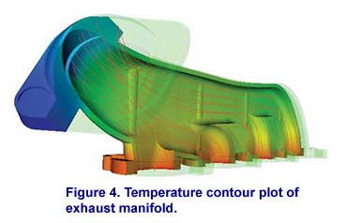
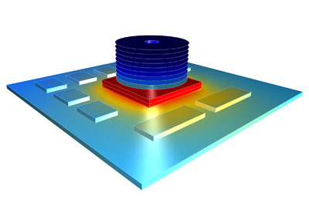

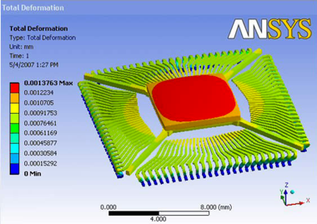

There are various available tools for solving coupled thermomechanical problems with FEM
Commercial tools
ABAQUS
ANSYS
COMSOL
Open source
MOOSE
NRC-based
FRAPCON/FRAPTRAN

Slide 8
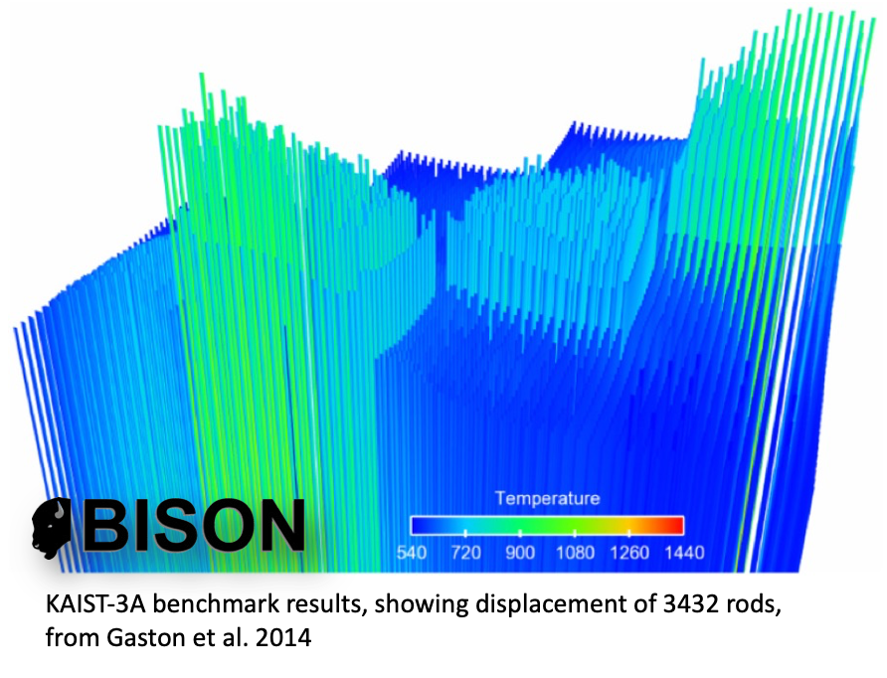
The purpose of a fuel performance code is to simulate and evaluate fuel rod behavior
The first fuel performance codes were developed in the mid seventies
Advanced fuel performance codes are still under development today

Slide 9
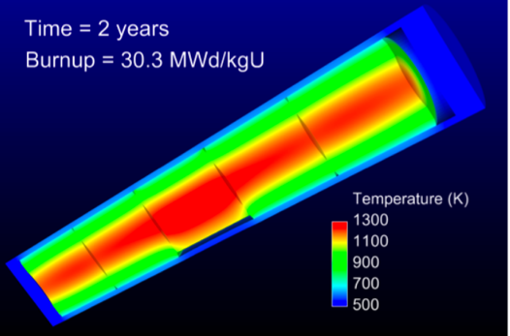
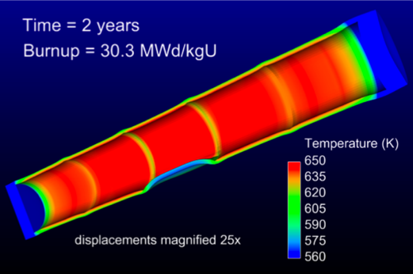
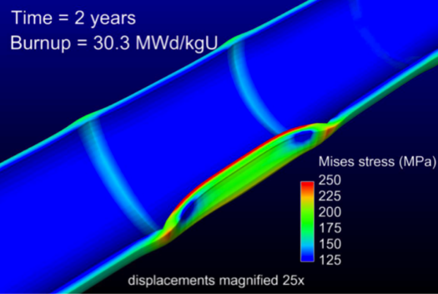
How are fuel performance codes used?
The primary goals are to predict the fuel centerline temperature and the stress in the cladding
Fuel performance codes aren’t focused on predicting power production, but rather to predict safety margins, provide coupling to other codes

Slide 10
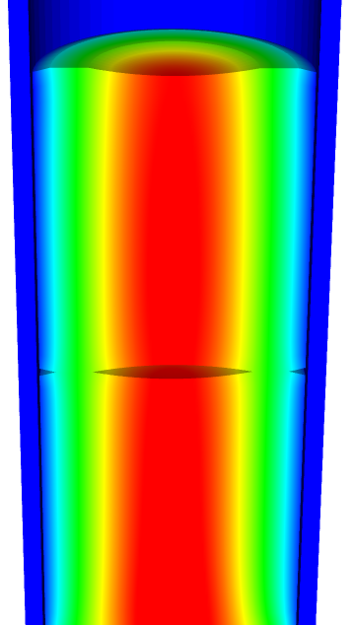
A fuel performance code must be able to predict:
Fuel
Temperature profile
Volumetric change
Gap
Gap heat transport
Mechanical interaction between fuel and cladding
Gap pressure
Cladding
Temperature profile
Stress

Slide 11
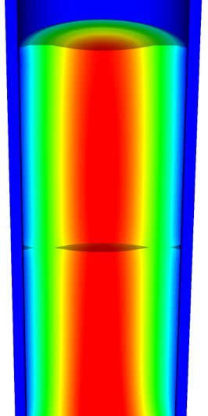
The primary focus is solving the thermomechanical problem
Fuel
Solved Numerically
Gap
The handling of the gap changes the most between different codes
Solved Numerically or analytically
Cladding
Solved Numerically or analytically
Solved Numerically

Slide 12
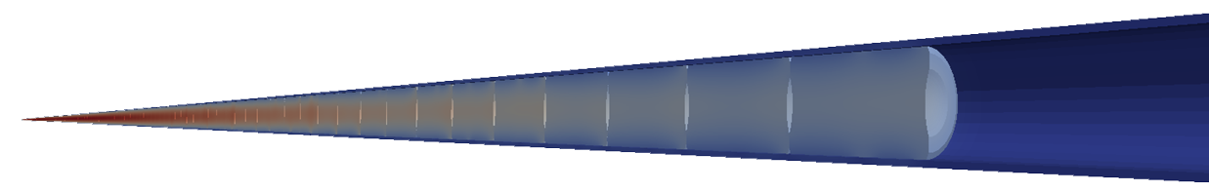
Various approaches to model the fuel rod
Transient, full 3D
Transient, 2D axisymmetric with discrete pellets
Computational cost
Accuracy
Transient, 2D axisymmetric with smeared pellets
Transient, multiple 1D slices (1.5D)
Steady, multiple 1D slices (1.5 D)
Transient, 1D
Steady state, 1D (analytical)

Slide 13
Early fuel performance codes were made for either steady state or transient operation
Steady state codes
Leave off the time derivative part of the heat equation
The material properties still evolve with time as a function of burnup
The volumetric changes in the fuel are also a function of burnup
Creep of fuel and cladding change with time
Transient codes
Include the time derivative
Have similar burnup dependent models like steady state codes, but don’t include creep
Have additional models for rapid transients

Slide 14
Start with FRAPCON
Transient, full 3D
Transient, 2D axisymmetric with discrete pellets
Computational cost
Accuracy
Transient, 2D axisymmetric with smeared pellets
Transient, multiple 1D slices (1.5D)
Steady, multiple 1D slices (1.5 D)
Transient, 1D
Steady state, 1D (analytical)

Slide 15
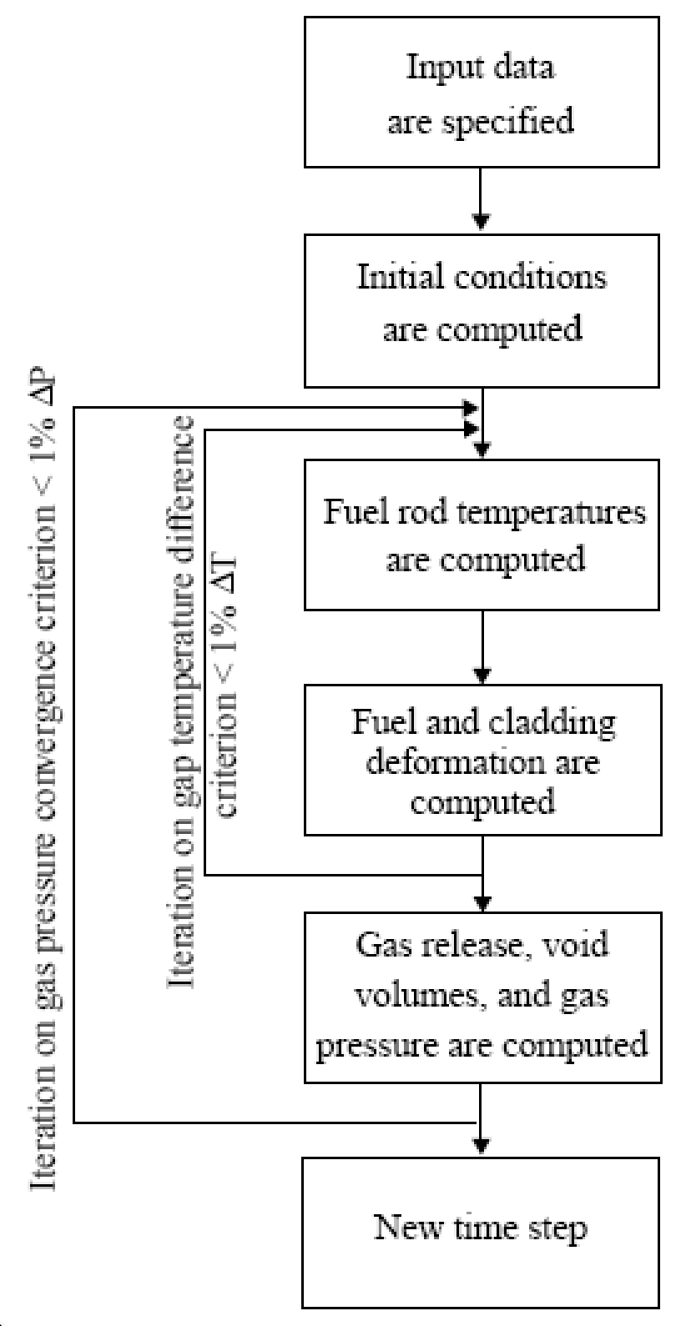
FRAPCON Flow Chart
FRAPCON is the NRC’s steady-state fuel performance code
FRAPCON has the ability to accurately calculate the high-burnup response of light-water reactor fuel rods
FRAPCON iterates to determine fuel rod temperatures, fuel and cladding deformation
This converged data is iterated to produce gas release, void volumes and plenum pressure
Then marches forward in time

Slide 16
FRAPTRAN
Transient, full 3D
Transient, 2D axisymmetric with discrete pellets
Computational cost
Accuracy
Transient, 2D axisymmetric with smeared pellets
Transient, multiple 1D slices (1.5D)
Steady, multiple 1D slices (1.5 D)
Transient, 1D
Steady state, 1D (analytical)

Slide 17
FALCON
Transient, full 3D
Transient, 2D axisymmetric with discrete pellets
Computational cost
Accuracy
Transient, 2D axisymmetric with smeared pellets
Transient, multiple 1D slices (1.5D)
Steady, multiple 1D slices (1.5 D)
Transient, 1D
Steady state, 1D (analytical)

Slide 18
FALCON
FALCON is a 2D fuel performance code developed by EPRI
Development of FALCON started in 1996
The beta version was released in 2003
It was developed by ANATECH for EPRI
FALCON is proprietary, owned by EPRI
It is no longer under active development in the US

Slide 19
FALCON is a 2D transient and steady state code
Fuel
Solved with FEM
Gap
Pressure is calculated using equation of state
Simplified contact model is used for gap closure
Gap heat transfer model is used
Solved with FEM
Cladding
Solved with FEM
Solved with FEM

Slide 20
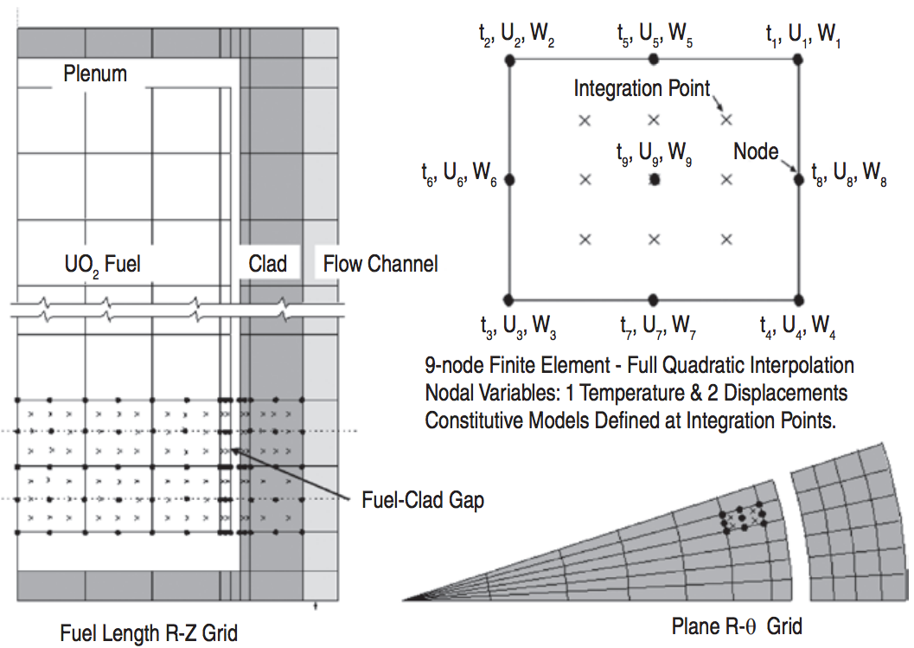
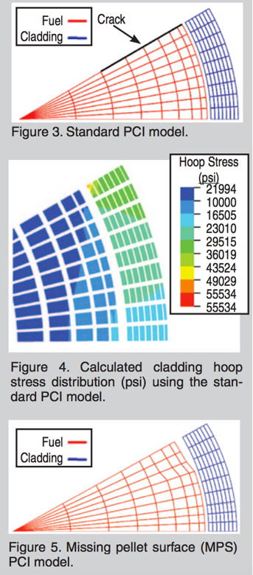
FALCON can predict the fuel performance in axisymmetric RZ space or in Rθ space

Slide 21
BISON
Transient, full 3D
Transient, 2D axisymmetric with discrete pellets
Computational cost
Accuracy
Transient, 2D axisymmetric with smeared pellets
Transient, multiple 1D slices (1.5D)
Steady, multiple 1D slices (1.5 D)
Transient, 1D
Steady state, 1D (analytical)

Slide 22
BISON
The next generation fuel performance code under development in the US
It uses the MOOSE framework
Development was begun in 2008
The first paper using BISON was published in 2009 and the paper summarizing its full capabilities was published in 2012
It was developed at Idaho National Laboratory, with some support by ANATECH
BISON is available for free, but it is export controlled and requires a license agreement be signed

Slide 23
BISON models the fuel behavior ranging from 1D to full 3D and uses FEM
Fuel
Solved with FEM
Gap
Pressure is calculated using equation of state
Fully implemented implicit contact algorithm
Gap heat transfer model is used
Solved with FEM
Cladding
Solved with FEM
Solved with FEM

Slide 24
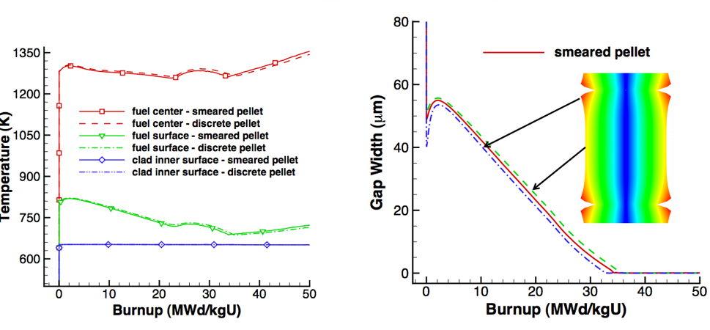
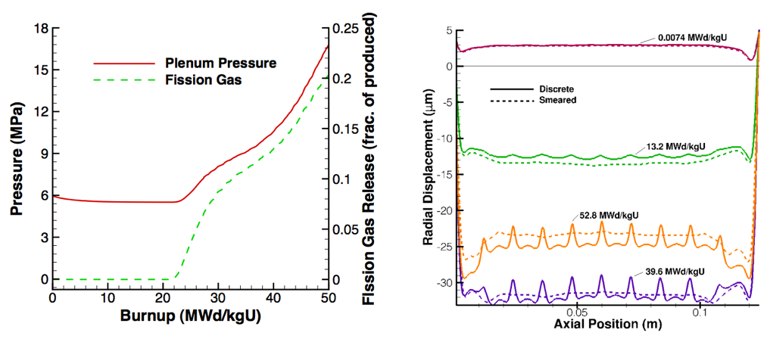
Can handle smeared or discrete pellets, asymmetric pellet geometry and deformation

Slide 25
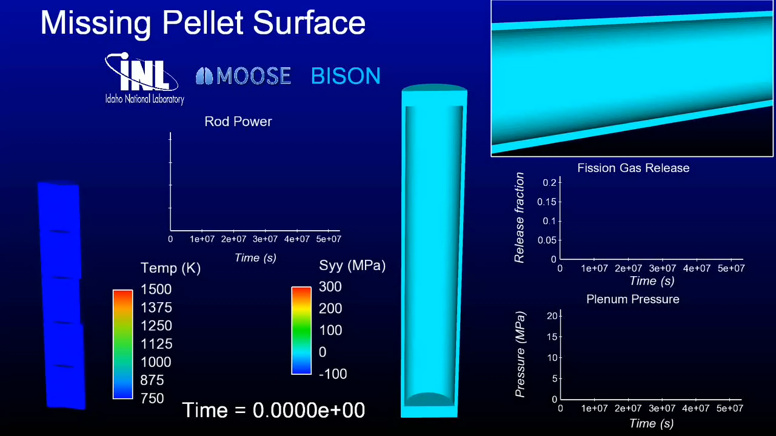
Because of its unique 3D capability, BISON can model truly 3D fuel performance problems

Slide 26
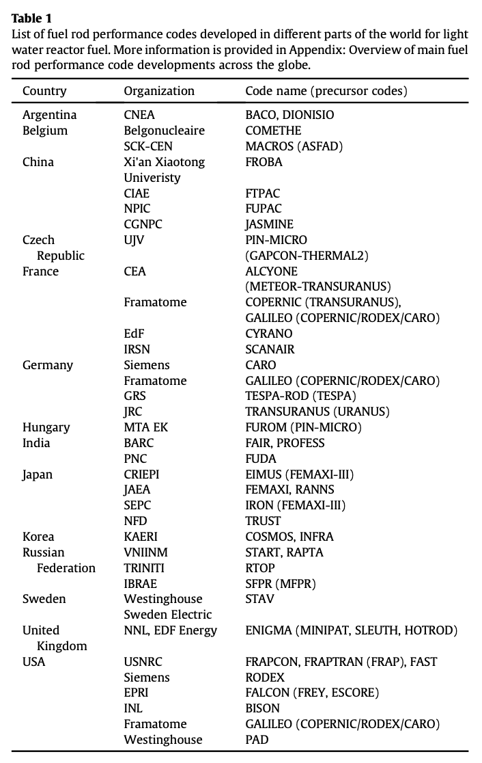
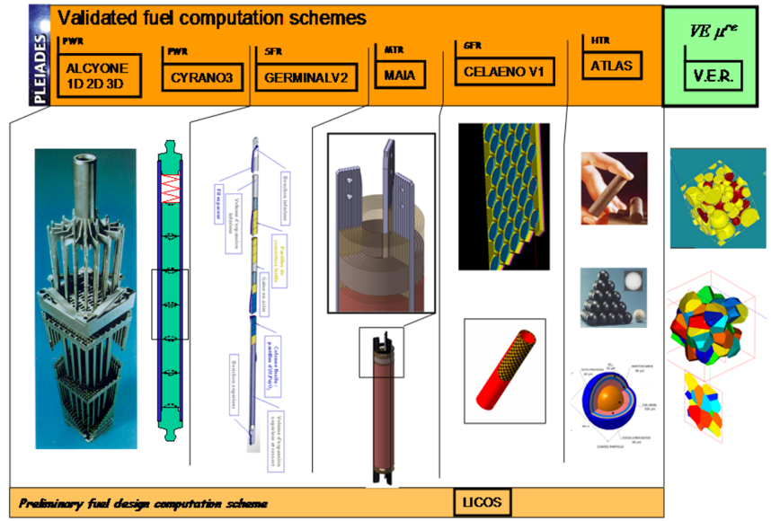
Other countries have other fuel performance codes
http://www.materials.cea.fr/en/PDF/PLEIADES-Platform.pdf

Slide 27
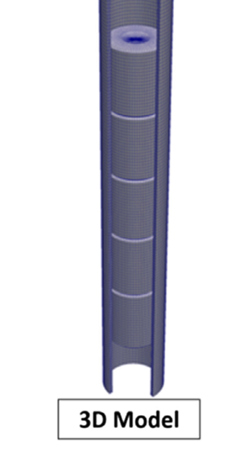
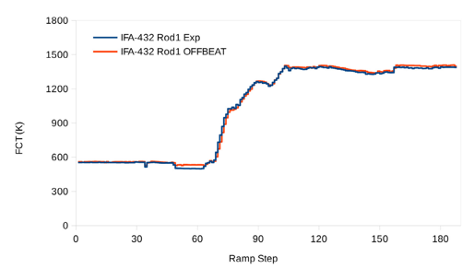
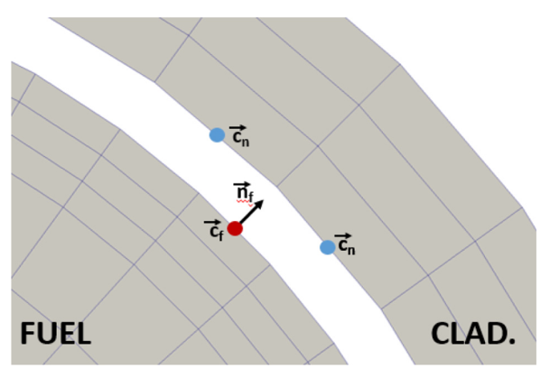
OFFBEAT – new tool
The OpenFOAM Fuel BEhavior Analysis Tool (OFFBEAT) is a multi-dimensional fuel performance code developed in Switzerland
The code can be used both for studying complex 2D or 3D local effects and for more traditional 1.5D base irradiation analyses
OFFBEAT is based on the open-source C++ library OpenFOAM, thus the governing equations are discretized with modern finite volume techniques

Slide 28
Summary
Fuel performance codes are focused on predicting the center temperature of the pellet and the stress in the cladding
All fuel performance codes
Numerically model the temperature in the fuel
Numerically model the stress in the cladding
And consider gap pressure, closure, and heat transfer in some way
The primary US codes are
FRAPCON – Steady state 1.5D, uses finite difference
FRAPTRAN – Transient 1.5D, uses finite difference
FALCON – Steady or transient 2D, uses finite element
BISON – Steady or transient, 1D – 3D, uses finite element

Slide 29
mechanistic modeling

Slide 30


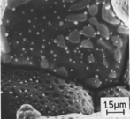
Microstructure-based fuel performance modeling
Structure/property relationships connect the microstructure variables to the property values
Operating Conditions
Neutron flux
Coolant T&P
Variables
Temperature
Displacement
Stoichiometry
Cladding
Property values
Microstructure evolution models
Microstructure evolution models
Fuel Property values
Elasticity tensor
Elasticity tensor
Grain growth
Grain growth
Cladding
Microstructure variables
Average grain size
Dislocation density
H concentration
Hydride fraction
Point defect concentrations
Loop density
2nd phase particle fraction
Fuel
Microstructure variables
Average grain size
Dislocation density
U defect concentrations
Pu concentration
Fission product precipitate fractions
Dissolved fission products
Fission gas bubble fraction
Grain boundary fission gas bubble coverage
Crack parameter
Plasticity
Plasticity
Thermal conductivity
Yield stress
Defect prod. & transport
Defect prod. & transport
Fracture stress
Thermal conductivity
Hydrogen transport
Fission gas behavior
Melting temperature
Failure criteria
Loop evolution
Densification
Diffusion constants
Dimensional change
Gap variable
Gap fission gas concentration
Fracture
Dimensional change

Slide 31

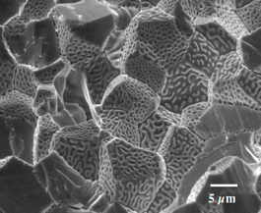
Example: fission gas behavior in the fuel
Take into account a finite set of variables to describe the state of the material
Utilize a mechanistic model of fission gas behavior to predict the evolution of the microstructure
Utilize this updated microstructure to inform a number of structure/property relationships
Variables
Temperature
Displacement
Stoichiometry
Elasticity tensor
Thermal conductivity
Model of fission gas behavior
Structure/property relationships
Fracture stress
Dissolved fission products
Fission gas bubble fraction
Grain boundary fission gas bubble coverage
Gap fission gas concentration
Dimensional change
Gap conductance
Gap pressure

Slide 32

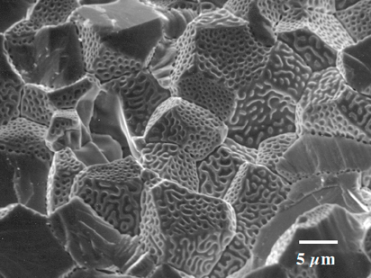
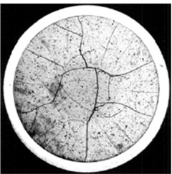
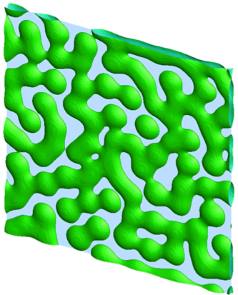
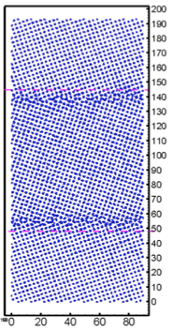
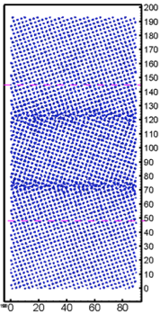
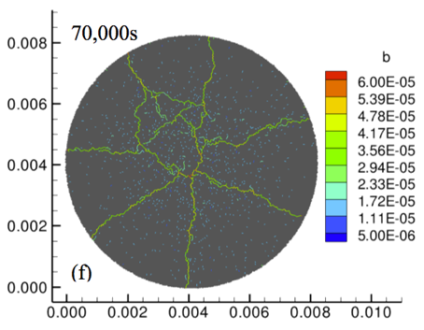
Multiscale separate effects experiments and simulations inform the development of the models
nm
μm
mm

Slide 33
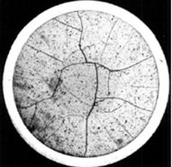
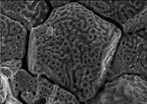
Microstructure-based models
Can provide a structure/property relationship to replace the existing burnup dependent model
For example, thermal conductivity, taking into account microstructural features and their evolution
Grain boundary and bubbles
Intragranular porosity
Precipitated fission products
κ_{pr}
Bulk conductivity
Vacancies and interstitials
Fission gas

Slide 34
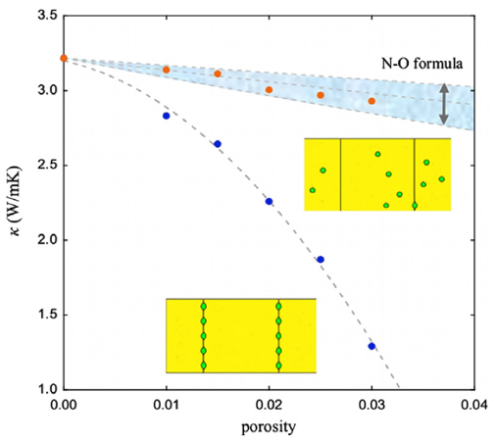
Parametrizing the mechanistic model
We employ multiscale modeling and simulation to determine the various parameters for the model
MD simulations conducted at LANL have been used to determine the coefficients for various point defects
MD simulations have shown that phonon scattering must be accounted for to accurately represent small bubbles
Mesoscale simulations have shown that GrB bubbles have a larger impact on the thermal conductivity
Maxwell-Eucken (no phonon scattering)

Slide 35
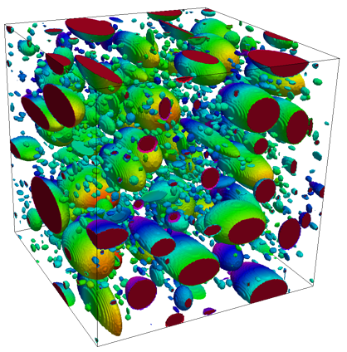
Parametrizing the mechanistic model
A thermal resistor model is created to describe the impact of GrB bubbles on the thermal conductivity
MARMOT simulations are currently being used to inform the development of the precipitate multiplier

Slide 36
Parametrizing the mechanistic model
Each term in the expression must be coupled to a corresponding state variable
The full model calculates the thermal conductivity as a function of:
Temperature
Point defect concentrations
Intragranular bubble density and average radius
Fractional coverage of bubbles on GBs and average radius
Precipitate volume fractions and average sizes
Currently effects of precipitate fission products and individual point defects are neglected in the model, as they are not tracked or predicted in BISON

Slide 37
Comparing with experiments…
The model under-predicts the temperature in most cases, but not all
Thus, the model is neglecting some resistive effects from the microstructure
Generally performs as well, and in some cases better, than the burnup based model
RISO-3 AN3
RISO-3 AN4
RISO II-3
US PWR TSQ0002

Slide 38
UZr Fuel Performance Modeling
Development of a quantitative phase-field model of macroscale constituent redistribution in the U-Zr system, where model parameters were optimized, and the model validated against an independent data set
Calculation of surface tension based on molecular dynamics, which is used in the BISON gaseous metallic fuel swelling model

Slide 39
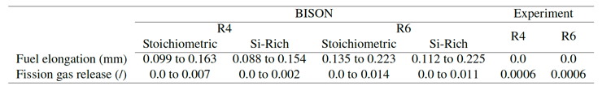
U3Si2 Fuel Performance Modeling
Point Defect Diffusion, Fission gas swelling, thermal and irradiation creep

Slide 40
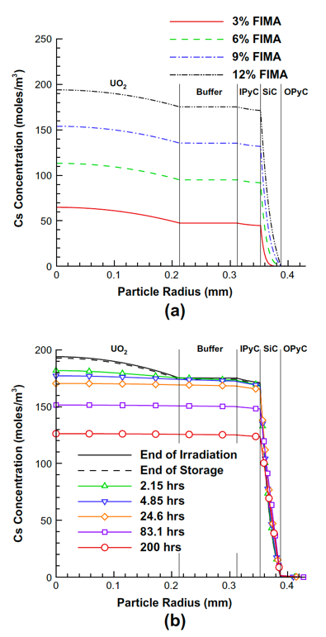
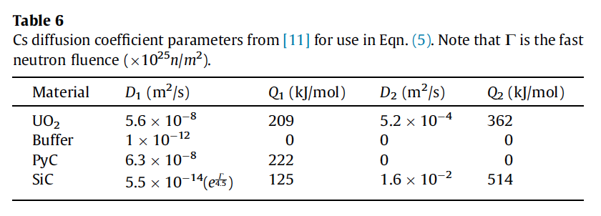
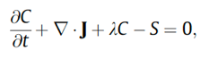
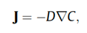
TRISO Particle Fuel Performance Modeling
TRISO particle modeling is still under development from a mechanistic model standpoint
Imperfect data for many critical fission products through different layers
Data typically for UO2 only, not for UC or UCO fuel kernels

Slide 41
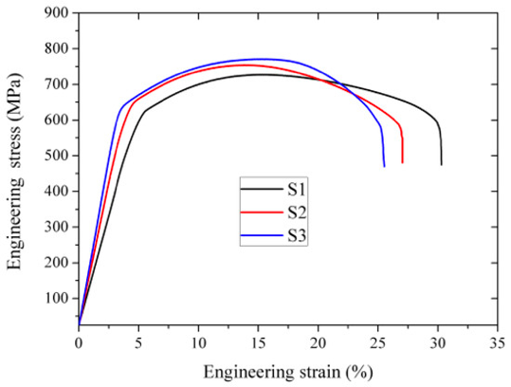
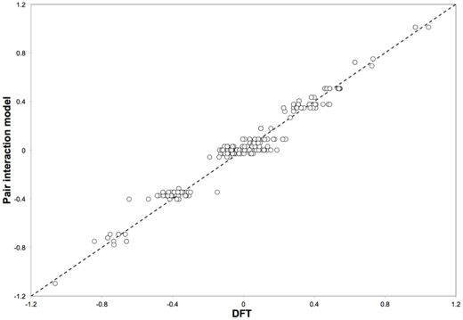
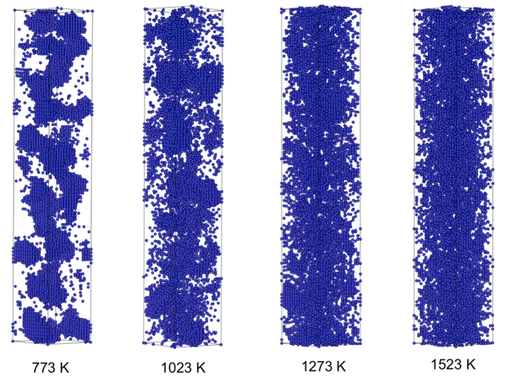
FeCrAl
Evolution of compositional randomness (precipitation) will affect the mechanical properties of FeCrAl
Kinetic Monte Carlo simulations modeled the precipitation of alpha’ phase from bcc Fe-Cr alloys under thermal aging at various temperatures
Fe-Al alloys do not show any phase separation
Can determine critical temperatures for precipitation and the resulting microstructures to investigate potential hardening

Slide 42
Summary
Researchers are working to develop materials models for the fuel and cladding that are mechanistic rather than empirical and that are based on the evolution of the microstructure rather than the burnup

